Slide 1
5/30
Ch 16 – Distributed Computing
NEU – 2016

Slide 2
Client/Server, Clustering
Client
Interconnected machine requesting information
Server
Interconnected machine providing information or resources
Application Programming Interface (API)
Set of functions and calls to allow client/server communication and interaction

Slide 3
Additional Terminology
Middleware
Drivers, API, and software to facilitate interaction between client/user and server
Includes Web servers, application servers, content management systems
Integral to information technology based on Extensible Markup Language (XML), Simple Object Access Protocol (SOAP), SOA, etc.

Slide 4
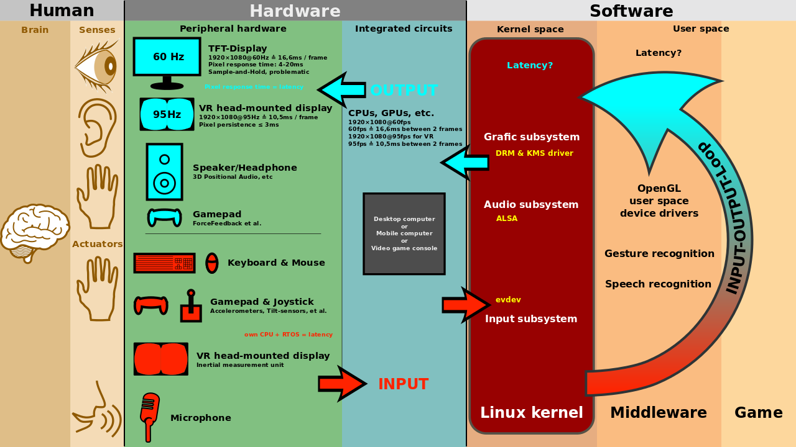
Gaming middleware
Notes:
https://en.wikipedia.org/wiki/Middleware#/media/File:Linux_kernel_and_gaming_input-output_latency.svg

Slide 5
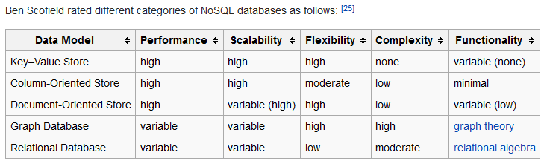
Databases
Relational Database
Structured Data
Structured Query Language (SQL)
Unstructured (BIG) data…?
NoSQL databases
Notes:
https://en.wikipedia.org/wiki/NoSQL

Slide 6
Distributed Databases ACID
Atomicity
Each transaction is "all or nothing“
If one part of the transaction fails, the entire transaction fails, and the database state is left unchanged
Consistency
Any transaction will bring the database from one valid state to another.
Any data written to the database must be valid according to all defined rules, including constraints, cascades, triggers, and any combination thereof.
Notes:
https://en.wikipedia.org/wiki/ACID

Slide 7
Distributed Databases ACID
Isolation
Concurrent execution of transactions results in a system state that would be obtained if transactions were executed serially
(idea of mutual exclusion)
Durability
Once a transaction has been committed, it will remain so, even in the event of power loss, crashes, or errors
(secondary memory)
Notes:
https://en.wikipedia.org/wiki/ACID

Slide 8
CAP (Brewer’s) Theorem
Impossible for a distributed system to simultaneously provide all three of the following guarantees
Consistency (all nodes see the same data at the same time)
Availability (a guarantee that every request receives a response about whether it succeeded or failed)
Partition tolerance (the system continues to operate despite arbitrary partitioning due to network failures)
Notes:
https://en.wikipedia.org/wiki/CAP_theorem

Slide 9
Client/Server Computing
Heavily Network Dependent
Application-level tasks
Interfaces through an API
Work Burden can be split between the Client and Server
Consider the Computation to Communication ratio

Slide 10
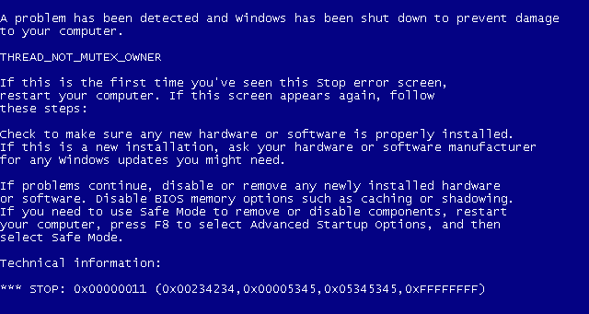
Inefficient client/server usage
Notes:
Now consider the scenario of Figure 16.4b , which has the same 1-millionrecord
database. In this case, a single query results in the transmission of 300,000
records over the network. This might happen if, for example, the user wishes to find
the grand total or mean value of some field across many records or even the entire
database.
Clearly, this latter scenario is unacceptable. One solution to this problem,
which maintains the client/server architecture with all of its benefits, is to move
part of the application logic over to the server. That is, the server can be equipped
with application logic for performing data analysis as well as data retrieval and data
searching.

Slide 11
Notes:
Figure 16.3 suggests that all of the application logic—the software for “number
crunching” or other types of data analysis—is on the client side, while the server is
only concerned with managing the database. Whether such a configuration is appropriate
depends on the style and intent of the application. For example, suppose that
the primary purpose is to provide online access for record lookup. Figure 16.4a suggests
how this might work. Suppose that the server is maintaining a database of 1
million records (called rows in relational database terminology), and the user wants
to perform a lookup that should result in zero, one, or at most a few records. The
user could search for these records using a number of search criteria (e.g., records
older than 1992, records referring to individuals in Ohio, records referring to a specific
event or characteristic, etc.). An initial client query may yield a server response
that there are 100,000 records that satisfy the search criteria. The user then adds
additional qualifiers and issues a new query. This time, a response indicating that
there are 1,000 possible records is returned. Finally, the client issues a third request
with additional qualifiers. The resulting search criteria yield a single match, and the
record is returned to the client.
The preceding application is well suited to a client/server architecture for two
reasons:
1. There is a massive job of sorting and searching the database. This requires
a large disk or bank of disks, a high-speed CPU, and a high-speed I/O architecture.
Such capacity and power is not needed and is too expensive for a
single-user workstation or PC.
2. It would place too great a traffic burden on the network to move the entire
1-million record file to the client for searching. Therefore, it is not enough for
the server just to be able to retrieve records on behalf of a client; the server
needs to have database logic that enables it to perform searches on behalf of
a client.

Slide 12
Notes:
As an example that illustrates the concept of splitting
application logic between client and server, let us consider one of the most common
families of client/server applications: those that use relational databases. In this
environment, the server is essentially a database server. Interaction between client
and server is in the form of transactions in which the client makes a database request
and receives a database response.
Figure 16.3 illustrates, in general terms, the architecture of such a system. The
server is responsible for maintaining the database, for which purpose a complex
database management system software module is required. A variety of different
applications that make use of the database can be housed on client machines. The
“glue” that ties client and server together is software that enables the client to make
requests for access to the server’s database. A popular example of such logic is the
structured query language (SQL).

Slide 13
Notes:
The key feature of a client/server architecture is the allocation of application-level tasks
between clients and servers. Figure 16.2 illustrates the general case.

Slide 14

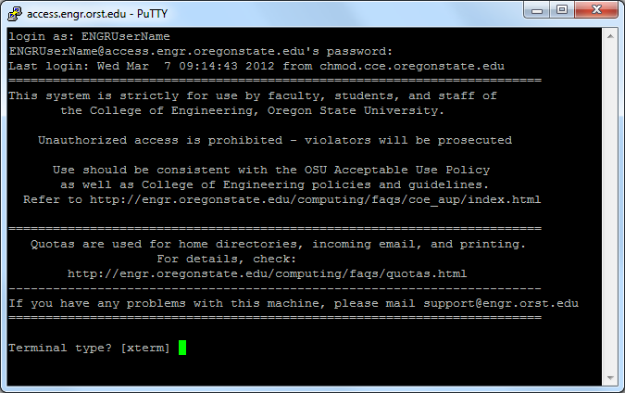
Putty
Not true client/server computing
Traditional mainframe environment in which all or virtually all of the processing is done on a central host
Often the user interface is via a dumb terminal
The user’s station is generally limited to the role of a terminal emulator
Notes:
Within the general framework of
client/server, there is a spectrum of implementations that divide the work between
client and server differently. Figure 16.5 illustrates in general terms some of the
major options for database applications. Other splits are possible, and the options
may have a different characterization for other types of applications. In any case, it
is useful to examine this figure to get a feel for the kind of trade-offs possible.
Figure 16.5 depicts four classes:
• Host-based processing: Host-based processing is not true client/server computing
as the term is generally used. Rather, host-based processing refers to the
traditional mainframe environment in which all or virtually all of the processing
is done on a central host. Often the user interface is via a dumb terminal.
Even if the user is employing a microcomputer, the user’s station is generally
limited to the role of a terminal emulator.

Slide 15
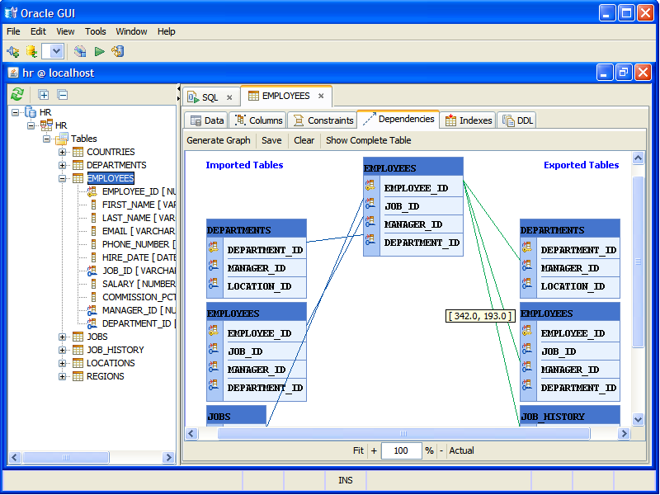
Server does all the processing
Client provides a graphical user interface
Rationale behind configuration is that the user workstation is best suited to providing a user-friendly interface and that databases and applications can easily be maintained on central systems
User gains the advantage of a better interface
Notes:
The most basic class of client/server configuration
is one in which the client is principally responsible for providing a graphical
user interface, while virtually all of the processing is done on the server. This
configuration is typical of early client/server efforts, especially departmental level
systems. The rationale behind such configurations is that the user workstation
is best suited to providing a user-friendly interface and that databases
and applications can easily be maintained on central systems. Although the
user gains the advantage of a better interface, this type of configuration does
not generally lend itself to any significant gains in productivity or to any fundamental
changes in the actual business functions that the system supports.

Slide 16
Application processing is performed in an optimized fashion
Complex to set up and maintain
Offers greater productivity and efficiency
Notes:
In a cooperative processing configuration, the
application processing is performed in an optimized fashion, taking advantage
of the strengths of both client and server machines and of the distribution of
data. Such a configuration is more complex to set up and maintain but, in the
long run, this type of configuration may offer greater user productivity gains
and greater network efficiency than other client/server approaches.

Slide 17
All application processing is done at the client
Data validation routines and other database logic functions are done at the server
Some of the more sophisticated database logic functions are housed on the client side
This architecture is perhaps the most common client/server approach in current use
It enables the user to employ applications tailored to local needs
Notes:
At the other extreme, virtually all application
processing may be done at the client, with the exception of data validation
routines and other database logic functions that are best performed at the
server. Generally, some of the more sophisticated database logic functions
are housed on the client side. This architecture is perhaps the most common
client/server approach in current use. It enables the user to employ applications
tailored to local needs.

Slide 18
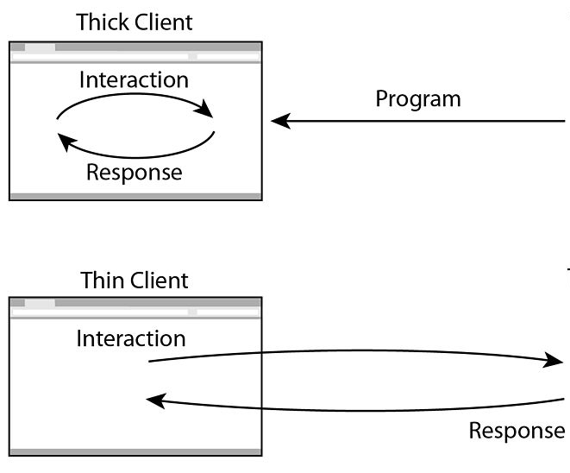
Processing responsibility
Thick vs Thin clients
Multi-Tier Server Side
Notes:
The traditional client/server
architecture involves two levels, or tiers: a client tier and a server tier. A three tier
architecture is also common ( Figure 16.6 ). In this architecture, the application
software is distributed among three types of machines: a user machine, a middle-tier
server, and a backend server. The user machine is the client machine we have been
discussing and, in the three-tier model, is typically a thin client. The middle-tier
machines are essentially gateways between the thin user clients and a variety of
backend database servers. The middle-tier machines can convert protocols and map
from one type of database query to another. In addition, the middle-tier machine
can merge/integrate results from different data sources. Finally, the middle-tier
machine can serve as a gateway between the desktop applications and the backend
legacy applications by mediating between the two worlds.
The interaction between the middle-tier server and the backend server also
follows the client/server model. Thus, the middle-tier system acts as both a client
and a server.

Slide 19
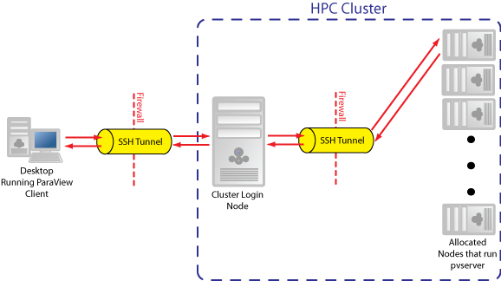
Multi-Tier Example: ParaView
ParaView is an open-source, multi-platform data analysis and visualization application.
Notes:
http://www.paraview.org/

Slide 20
File Cache Consistency
Performance of file I/O can be noticeably degraded by network performance
File caches hold recently accessed file records
A local file cache should reduce the number of remote server accesses that must be made (principle of locality)
How to maintain cache consistency ?
Readers Writers Approach
Notes:
When a file server is used, performance of file I/O can
be noticeably degraded relative to local file access because of the delays imposed
by the network. To reduce this performance penalty, individual systems can use file
caches to hold recently accessed file records. Because of the principle of locality, use
of a local file cache should reduce the number of remote server accesses that must
be made.

Slide 21
Notes:
Figure 16.8 suggests the role of middleware in a
client/server architecture. The exact role of the middleware component will depend
on the style of client/server computing being used. Referring back to Figure 16.5 ,
recall that there are a number of different client/server approaches, depending on
the way in which application functions are split up. In any case, Figure 16.8 gives a
good general idea of the architecture involved.
Note that there is both a client and server component of middleware. The
basic purpose of middleware is to enable an application or user at a client to access
a variety of services on servers without being concerned about differences among
servers. To look at one specific application area, the structured query language
(SQL) is supposed to provide a standardized means for access to a relational database
by either a local or remote user or application. However, many relational
database vendors, although they support SQL, have added their own proprietary
extensions to SQL. This enables vendors to differentiate their products but also
creates potential incompatibilities.
As an example, consider a distributed system used to support, among other
things, the personnel department. The basic employee data, such as employee name
and address, might be stored on a Gupta database, whereas salary information
might be contained on an Oracle database. When a user in the personnel department
requires access to particular records, that user does not want to be concerned
with which vendor’s database contains the records needed. Middleware provides a
layer of software that enables uniform access to these differing systems.

Slide 22
Notes:
It is instructive to look at the role of middleware from a logical, rather than
an implementation, point of view. This viewpoint is illustrated in Figure 16.9 .
Middleware enables the realization of the promise of distributed client/server computing.
The entire distributed system can be viewed as a set of applications and
resources available to users. Users need not be concerned with the location of data
or indeed the location of applications. All applications operate over a uniform
applications programming interface (API). The middleware, which cuts across all
client and server platforms, is responsible for routing client requests to the appropriate
server.

Slide 23
Common Object Request Broker Architecture (CORBA) enables communication between
software written in different languages and running on different computers.
Implementation details from specific operating systems, programming languages, and
hardware platforms are all removed from the responsibility of developers who use CORBA
Notes:
Figure 16.10a shows the use of message passing to implement client/server
functionality. A client process requires some service (e.g., read a file, print) and
sends a message containing a request for service to a server process. The server
process honors the request and sends a message containing a reply. In its simplest
form, only two functions are needed: Send and Receive. The Send function specifies
a destination and includes the message content. The Receive function tells from
whom a message is desired (including “all”) and provides a buffer where the incoming
message is to be stored.

Slide 24
Notes:
Figure 16.10a shows the use of message passing to implement client/server
functionality. A client process requires some service (e.g., read a file, print) and
sends a message containing a request for service to a server process. The server
process honors the request and sends a message containing a reply. In its simplest
form, only two functions are needed: Send and Receive. The Send function specifies
a destination and includes the message content. The Receive function tells from
whom a message is desired (including “all”) and provides a buffer where the incoming
message is to be stored.

Slide 25
Blocking,
Non-blocking
Parallel Virtual Machine (PVM)
Message Passing Interface (MPI)
Notes:
Figure 16.11 suggests an implementation for message passing. Processes make
use of the services of a message-passing module. Service requests can be expressed in
terms of primitives and parameters. A primitive specifies the function to be performed,
and the parameters are used to pass data and control information. The actual form of
a primitive depends on the message-passing software. It may be a procedure call or it
may itself be a message to a process that is part of the operating system.
The Send primitive is used by the process that desires to send the message.
Its parameters are the identifier of the destination process and the contents of the
message. The message-passing module constructs a data unit that includes these two
elements. This data unit is sent to the machine that hosts the destination process,
using some sort of communications facility, such as TCP/IP. When the data unit
is received in the target system, it is routed by the communications facility to the
message-passing module. This module examines the process ID field and stores the
message in the buffer for that process.
In this scenario, the receiving process must announce its willingness to receive
messages by designating a buffer area and informing the message-passing module
by a Receive primitive. An alternative approach does not require such an announcement.
Instead, when the message-passing module receives a message, it signals the
destination process with some sort of Receive signal and then makes the received
message available in a shared buffer.
Several design issues are associated with distributed message passing, and
these are addressed in the remainder of this section.

Slide 26
Notes:
The remote procedure call mechanism can be viewed as a refinement of reliable,
blocking message passing. Figure 16.10b illustrates the general architecture.
Figure 16.12 provides a more detailed look. The calling program makes a normal
procedure call with parameters on its machine. For example,
Consider a procedure call:
CALL P(X,Y)
Where:
P = procedure name
X = passed arguments
Y = returned values
It may or may not be transparent to the user that the intention is to invoke a remote procedure on some other machine.
A dummy or stub procedure P must be included in the caller’s address space or be dynamically linked to it at call time.
This procedure creates a message that identifies the procedure being called and includes the parameters.
It then sends this message to a remote system and waits for a reply.
When a reply is received, the stub procedure returns to the calling program, providing the returned values.
At the remote machine, another stub program is associated with the called procedure.
When a message comes in, it is examined and a local CALL P(X, Y) is generated.
This remote procedure is thus called locally, so its normal assumptions about where to find parameters, the state of the stack, and so on are identical to the case of a purely local procedure call.

Slide 27
Remote Procedure Calls
Allow programs on different machines to interact using simple procedure call/return semantics
Used for access to remote services
Passing data by values – great
Passing data by reference – not so great
Client/Server Binding
Persistent (Resources maintaining)
Non-persistent (Resources creating/destroying)
Notes:
A variation on the basic message-passing model is the remote procedure call. This
is now a widely accepted and common method for encapsulating communication
in a distributed system. The essence of the technique is to allow programs on
different machines to interact using simple procedure call/return semantics, just as
if the two programs were on the same machine. That is, the procedure call is used
for access to remote services. The popularity of this approach is due to the following
advantages.
1. The procedure call is a widely accepted, used, and understood abstraction.
2. The use of remote procedure calls enables remote interfaces to be specified
as a set of named operations with designated types. Thus, the interface can
be clearly documented and distributed programs can be statically checked for
type errors.
3. Because a standardized and precisely defined interface is specified, the
communication code for an application can be generated automatically.
4. Because a standardized and precisely defined interface is specified, developers
can write client and server modules that can be moved among computers
and operating systems with little modification and recoding.

Slide 28
Synchronous versus Asynchronous
Synchronous RPC
behaves much like a subroutine call
behavior is predictable
however, it fails to exploit fully the parallelism inherent in distributed applications
this limits the kind of interaction the distributed application can have, resulting in lower performance
Asynchronous RPC
does not block the caller
replies can be received as and when they are needed
allow client execution to proceed locally in parallel with server invocation
Notes:
The concepts of synchronous and asynchronous remote procedure calls are analogous
to the concepts of blocking and nonblocking messages. The traditional remote
procedure call is synchronous, which requires that the calling process wait until the
called process returns a value. Thus, the synchronous RPC behaves much like a
subroutine call.
The synchronous RPC is easy to understand and program because its behavior
is predictable. However, it fails to exploit fully the parallelism inherent in distributed
applications. This limits the kind of interaction the distributed application can
have, resulting in lower performance.
To provide greater flexibility, various asynchronous RPC facilities have been
implemented to achieve a greater degree of parallelism while retaining the familiarity
and simplicity of the RPC [ANAN92]. Asynchronous RPCs do not block the
caller; the replies can be received as and when they are needed, thus allowing client
execution to proceed locally in parallel with the server invocation.
A typical asynchronous RPC use is to enable a client to invoke a server repeatedly
so that the client has a number of requests in the pipeline at one time, each with its own
set of data. Synchronization of client and server can be achieved in one of two ways:
1. A higher-layer application in the client and server can initiate the exchange
and then check at the end that all requested actions have been performed.
2. A client can issue a string of asynchronous RPCs followed by a final synchronous
RPC. The server will respond to the synchronous RPC only after
completing all of the work requested in the preceding asynchronous RPCs.
In some schemes, asynchronous RPCs require no reply from the server and
the server cannot send a reply message. Other schemes either require or allow a
reply, but the caller does not wait for the reply.

Slide 29
Simple Object Access Protocol (SOAP)
A protocol specification for exchanging structured information
extensibility (security and WS-routing are among the extensions under development)
neutrality (SOAP can operate over any transport protocol such as HTTP, SMTP, TCP, UDP, or JMS)
independence (SOAP allows for any programming model)

Slide 30
Securing RPC over a network
Existing security mechanisms could employ packet/port filtering
Mechanisms like SOAP allow for RPCs to be bundled over HTTP/HTTPS
HTTP traffic is rarely blocked
Securing HTTP-based RPC access would require packet analysis

Slide 31
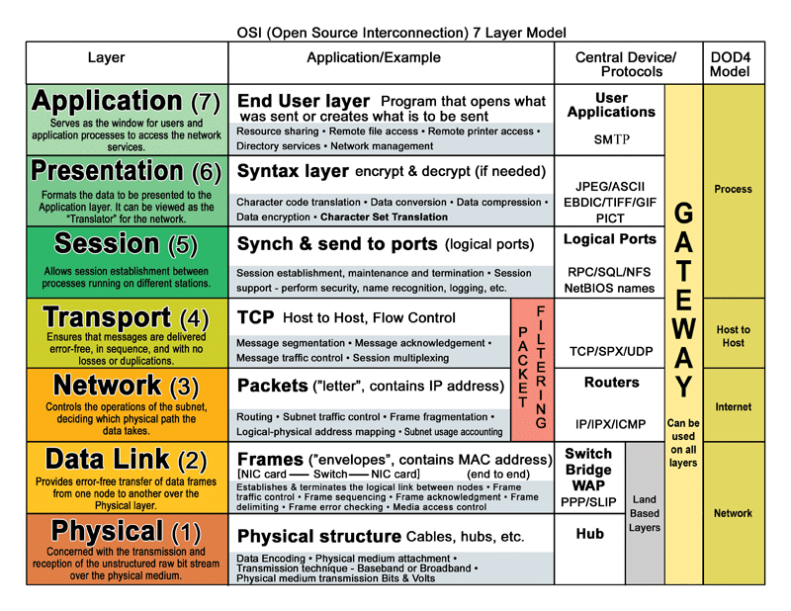
Notes:
Recall the ISO/OSI connection model…

Slide 32
Clusters
Abstraction of SMP computing
Symmetric Machines
Group of stand-alone machines working as one
Supercomputing

Slide 33
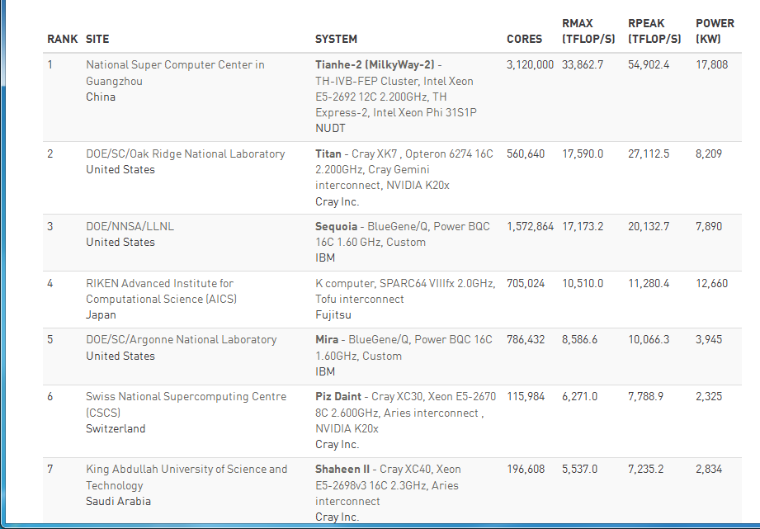
Top 500 (top500.org)

Slide 34
Benefits of Clusters
Absolute scalability
a cluster can have dozens or even hundreds of machines, each of which is a multiprocessor
Incremental scalability
configured in such a way that it is possible to add new systems to the cluster in small increments
High availability
failure of one node is not critical to system
Superior price/performance
by using commodity building blocks, it is possible to put together a cluster at a much lower cost than a single large machine
Notes:
[BREW97] lists four benefits that can be achieved with clustering. These can
also be thought of as objectives or design requirements:
• Absolute scalability: It is possible to create large clusters that far surpass the
power of even the largest stand-alone machines. A cluster can have dozens or
even hundreds of machines, each of which is a multiprocessor.
• Incremental scalability: A cluster is configured in such a way that it is possible
to add new systems to the cluster in small increments. Thus, a user can start
out with a modest system and expand it as needs grow, without having to go
through a major upgrade in which an existing small system is replaced with a
larger system.
• High availability: Because each node in a cluster is a stand-alone computer,
the failure of one node does not mean loss of service. In many products, fault
tolerance is handled automatically in software.
• Superior price/performance: By using commodity building blocks, it is possible
to put together a cluster with equal or greater computing power than a single
large machine, at much lower cost.

Slide 35
Notes:
In the literature, clusters are classified in a number of different ways. Perhaps the simplest
classification is based on whether the computers in a cluster share access to the
same disks. Figure 16.13a shows a two-node cluster in which the only interconnection
is by means of a high-speed link that can be used for message exchange to coordinate
cluster activity. The link can be a LAN that is shared with other computers that are
not part of the cluster or the link can be a dedicated interconnection facility. In the
latter case, one or more of the computers in the cluster will have a link to a LAN
or WAN so that there is a connection between the server cluster and remote client
systems. Note that in the figure, each computer is depicted as being a multiprocessor.
This is not necessary but does enhance both performance and availability.
In the simple classification depicted in Figure 16.13 , the other alternative is
a shared-disk cluster. In this case, there generally is still a message link between
nodes. In addition, there is a disk subsystem that is directly linked to multiple computers
within the cluster. In Figure 16.13b , the common disk subsystem is a RAID
system. The use of RAID or some similar redundant disk technology is common in
clusters so that the high availability achieved by the presence of multiple computers
is not compromised by a shared disk that is a single point of failure.

Slide 36
SERVERS!
Table 16.2
Clustering Methods: Benefits
and Limitations
Notes:
A clearer picture of the range of clustering approaches can be gained by looking
at functional alternatives. A white paper from Hewlett Packard [HP96] provides
a useful classification along functional lines (Table 16.2), which we now discuss.
A common, older method, known as passive standby , is simply to have one computer
handle all of the processing load while the other computer remains inactive,
standing by to take over in the event of a failure of the primary. To coordinate the
machines, the active, or primary, system periodically sends a “heartbeat” message to
the standby machine. Should these messages stop arriving, the standby assumes that
the primary server has failed and puts itself into operation. This approach
increases availability but does not improve performance. Further, if the only information that
is exchanged between the two systems is a heartbeat message, and if the two systems
do not share common disks, then the standby provides a functional backup but has
no access to the databases managed by the primary.
The passive standby is generally not referred to as a cluster. The term cluster is
reserved for multiple interconnected computers that are all actively doing processing
while maintaining the image of a single system to the outside world. The term
active secondary is often used in referring to this configuration. Three classifications
of clustering can be identified: separate servers, shared nothing, and shared memory.
In one approach to clustering, each computer is a separate server with its own
disks and there are no disks shared between systems ( Figure 16.13a ). This arrangement
provides high performance as well as high availability. In this case, some type
of management or scheduling software is needed to assign incoming client requests
to servers so that the load is balanced and high utilization is achieved. It is desirable
to have a failover capability, which means that if a computer fails while executing an
application, another computer in the cluster can pick up and complete the application.
For this to happen, data must constantly be copied among systems so that each
system has access to the current data of the other systems. The overhead of this data
exchange ensures high availability at the cost of a performance penalty.
To reduce the communications overhead, most clusters now consist of servers
connected to common disks ( Figure 16.13b ). In one variation of this approach,
called shared nothing , the common disks are partitioned into volumes, and each
volume is owned by a single computer. If that computer fails, the cluster must be
reconfigured so that some other computer has ownership of the volumes of the
failed computer.
It is also possible to have multiple computers share the same disks at the same
time (called the shared disk approach), so that each computer has access to all of the
volumes on all of the disks. This approach requires the use of some type of locking
facility to ensure that data can only be accessed by one computer at a time.

Slide 37
Cluster Considerations
Fault management
Failover (application switched to working node)
Failback (application restored on fixed system)
Load balancing
Job Scheduling & Resource Handling
Parallelization

Slide 38
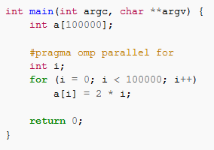
Parallelization
Application
Programmer defined (e.g., threading)
Compiler-driven
OpenMP
MATLAB
GPU
Parallelization

Slide 39
Beowulf Clusters
Initiated as a NASA project in 1994
Commercial Off the Shelf (COTS) components
Existing workstations
Stand-alone Linux machines
Raspberry Pi Cluster
http://www.zdnet.com/article/build-your-own-supercomputer-out-of-raspberry-pi-boards/
Youtube explanation & discussion https://www.youtube.com/watch?v=i_r3z1jYHAc

Slide 40
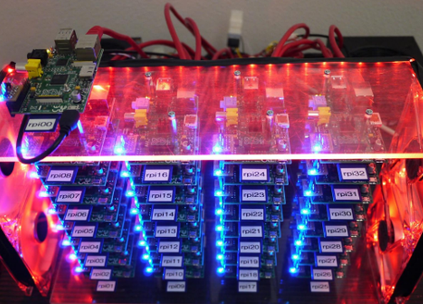
Kiepert ran the High Performance Linpack (HPL), the standard supercomputer benchmark on his home-made computer and found that his RPiCluster with its 32 Broadcom BCM2708 ARM11 processors running are 1GHz and 14.6GB of usable RAM turned in a HPL peak performance of 10.13 GFLOPS. That's not going to get this cluster into the TOP500 supercomputer list, but as Kiepert observed, "the first Cray-2 supercomputer in 1985 did 1.9 GFLOPS. How times have changed!"

Slide 41
Grid Computing
Heterogeneous Machines
Any OS/architecture
Berkeley Open Infrastructure for Network Computing (BOINC)
Globus Toolkit
Examples…

Slide 42
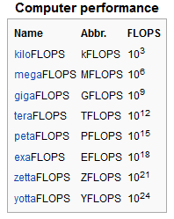
FLOPS
Floating point operations per second

Slide 43
Grid vs Supercomputers
SETI@home
0.677 PFLOPS
Folding@home
36.3 PFLOPS (equivalent)
Fastest Supercomputer (Top 500)
33.8 (peak 54.9) PFLOPS
BOINC
139 PFLOPS
Bitcoin Network
4,873,841 PFLOPS
4.8 ZFLOPS?
Notes:
https://en.wikipedia.org/wiki/Grid_computing

Slide 44
OS Considerations
Bitcoin
(No cooperation, no coordination)
BOINC
Users (nodes) pick tasks
BOINC handles distribution and collection of work
Clusters
Users submit jobs, which are assigned to nodes
Failure considerations
Memory (primary/secondary)

